Slide 1
Chap 6
By Lim WH 2012

Slide 2
Learning outcome
(a) give examples of energy in different forms, its conversion and conservation, and apply the principle of energy conservation to simple examples.

Slide 3
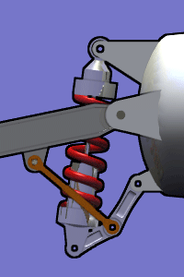
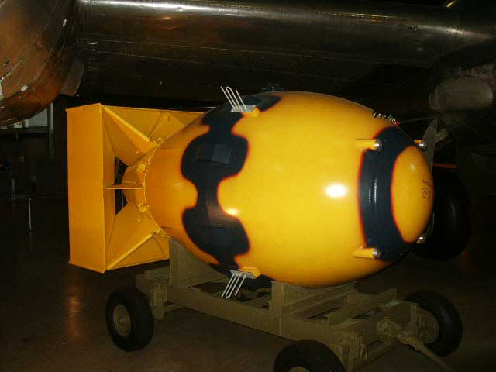
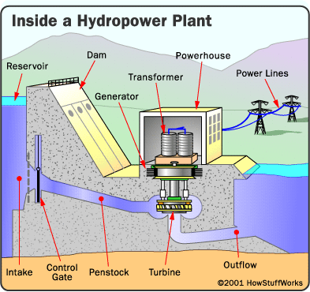

Car suspension system
Hydroelectric station
Atomic bomb

Slide 4
Learning outcome
(b) show an understanding of the concept of work in terms of the product of a force and displacement in the direction of the force

Slide 5
Work
the product of a force and displacement in the direction of the force.
W = Fs cos θ
θ Is the angle between (constant)F and s.
Nm, J
scalar quantity
W = <F> s cos θ ; where <F> is the average force
F
θ
s

Slide 6
Positive and negative values of work
F
θ
F
θ
s
s
0 ≤ θ < 90; W + ve
90 < θ ≤ 180; W −ve
F
W = Fs cos θ
-ve work done extracts energy from the system
+ve work done adds energy to the system
s
θ = 90; W zero

Slide 7
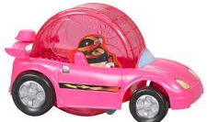
example
Determine the work done by
W sin θ
Work = W sin θ x s x cos 180
(ii) W cos θ
Work = W cos θ x s x cos 90
(iii) Normal reaction force
Work = N x s x cos 90
(iv) Friction
Work = friction x s x cos 180
(iv) thrust
Work = thrust x s x cos 0
s
Thrust
N
W cos θ
W sin θ
θ
Friction
Thrust - W sin θ - friction = ma
Constant speed, a=0
Thrust = W sin θ + friction

Slide 8
Try this
A toy car of 50 N is moving up on a ramp of 2 m with a constant speed 0.4 m s⁻¹. The ramp is 30º inclined to the horizontal. Constant frictional force 30 N acts on the car. A constant driving force is produced by the engine.
Determine the work done by each of the following forces:
i. the frictional force f exerted by the road on the car
ii. the component of car’s weight Wx down the slope
iii. the reaction force R exerted by the road on the car
iv. the driving force F of the engine

Slide 9
Try this
A toy car of 50 N moves up the slope by 2 m from rest with acceleration 0.8 m s⁻². The ramp is 30º inclined to the horizontal. Constant frictional force 30 N acts on the car. A constant driving force is produced by the engine.
Determine the work done by each of the following forces:
i. the frictional force f exerted by the road on the car
ii. the component of car’s weight Wx along the slope
iii. the reaction force R exerted by the road on the car
the resultant force
the driving force F of the engine

Slide 10
Learning outcomes
(c) calculate the work done in a number of situations including the work done by a gas that is expanding against a constant external pressure: W = p ΔV
(d) derive, from the equations of motion, the formula Ek = ½ mv²
(h) derive, from the defining equation W = Fs, the formula Ep = mgh for potential energy changes near the Earth’s surface
(i) recall and use the formula Ep = mgh for potential energy changes near the Earth’s surface

Slide 11
Work-energy theorem
W = Fs
= (ma)s
v²=u²+2as
as = (v²- u²)/2
W = ½ m (v²- u²)
= ½ mv² - ½ m u²
= change in KE
∴KE = ½ mv²
Work is done to increase KE
u
v
F
s

Slide 12
Work-energy theorem
(2) Work is done to increase GPE
F = mg while moving with constant speed
W = Fs
= mg(h₂- h₁)
=mgh₂- mgh₁
= change in GPE
∴ΔGPE = mgΔh
Near the surface of the earth
h₂
F
h₁

Slide 13

example
A ball of 550 g is rolling down a frictionless track at point A with 3 ms⁻¹. Assuming the ball is always in contact with the track, determine KE & PE of the ball at point A, B and C.
Total energy of a system is conserved.
In this case, at any point, the sum of KE and GPE is conserved.
If 6 J of energy is lost due to friction when the mass moves from A to C, determine the remaining KE at C

Slide 14
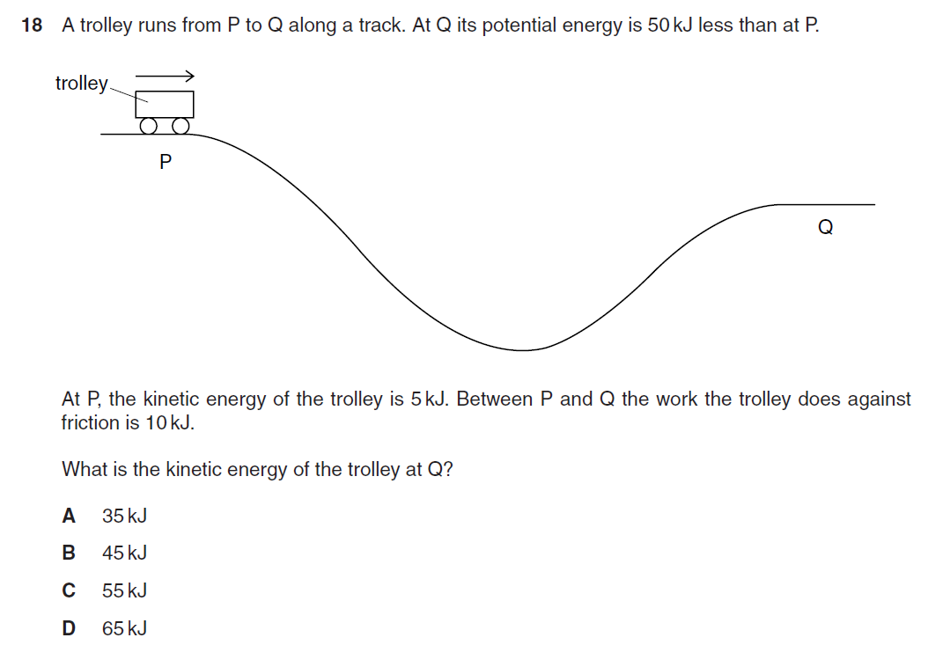
PYQ June02

Slide 15
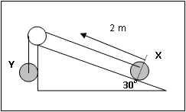
example
X and Y have a mass of 3 kg and 5 kg respectively. When X starts to travel 2.0 m along the plane, what is the total KE gained by the system?
[68.7J]

Slide 16

Work-energy theorem
(3) Work is done by gas to expand
W = Fs
W = (pA)Δx
p=F/A
W = p AΔx
A Δx = ΔV
W = pΔV

Slide 17
example
A rigid cylinder filled with air is heated. The frictionless piston pushes outwardly by 20 cm against the atmospheric pressure. The cross-sectional area of the cylinder is 15 cm².
Determine the work done by the gas in this expansion.
W= p Δ V = 1.01 x10⁵ x 15x10⁻⁴ x 0.2 = 30.3J

Slide 18
Work-energy theorem
(4) Work is done to increase Elastic PE
x
F _{applied} = F _{restoring}
W = Fs
= <F> x
<F> = (F_{max} + F_{min})/2
∴EPE = ½ Fx
F _{restoring}
F _{applied}
F
x

Slide 19
Learning outcome
(f) distinguish between gravitational potential energy, electric potential energy and elastic potential energy
Potential energy is the energy stored which has the ability to do work when there is an external work done against an opposing force .

Slide 20
GPE, EPE & EPE
gravitational potential energy – it is the ability to do work/ energy stored in a mass when it is moved against a gravitational field.
electric potential energy - it is the ability to do work/energy stored in a positive charge when it is moved against an electric field.
elastic potential energy - it is the ability to do work/ energy stored in an elastic material when there is a change in shape compared to its original shape (work against the restoring force exerted by the material)

Slide 21
Learning outcomes
(e) recall and apply the formula Ek = ½ mv²
(g) show an understanding and use the relationship between force and potential energy in a uniform field to solve problems

Slide 22
Motion up a ramp
In terms of forces
Thrust - W sin θ - Friction = ma
In terms of energy
Thrust x s- W sin θ x s - Friction x s = ma x s
Thrust x s = W sin θ x s + Friction x s + ma x s
s
Thrust
N
W cos θ
W sin θ
θ
Friction

Slide 23
Motion up a ramp
Thrust x s = W sin θ x s + Friction x s + ma x s
H/ s = sin θ
  H = s x sin θ
  W sin θ x s = mg x H
  Work done against gravity is stored as GPE.
Friction x s = work done against friction is dissipated as heat.
ma x s = m (v²- u²)/2 = increase in KE
s
Thrust
N
H
W cos θ
W sin θ
θ
Friction

Slide 24
Thrust x s = W sin θ x s + Friction x s + ma x s
= increase in GPE + heat dissipated + increase in KE
Thrust x s = ??
Total work done, W
Generally,
Total work done = increase in GPE + heat dissipated + increase in KE
Constant velocity, ΔKE = 0
On a horizontal surface , ΔGPE = 0
Smooth surface, no friction, no heat dissipated.
No engine, e.g. a trolley, W = 0

Slide 25
Review…
A toy car of 50 N moves up the slope by 2 m from rest with acceleration 0.8 m s⁻². Constant frictional force 30 N acts on the car. A constant driving force is produced by the engine.
Determine the work done by each of the following forces:
i. the frictional force f exerted by the road on the car
the component of car’s weight Wx along the slope
the resultant force
the driving force F of the engine
Determine :
Heat energy dissipated
Increase in GPE
Increase in KE
work done by engine

Slide 26
Learning outcomes
(j) show an understanding of the concept of internal energy
(k) recall and understand that the efficiency of a system is the ratio of useful work done by the system to the total energy input
(l) show an appreciation for the implications of energy losses in practical devices and use the concept of efficiency to solve problems

Slide 27
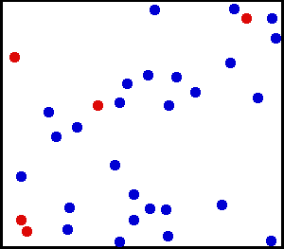

Internal energy
It is the sum of random distribution of KE and PE of all molecules of a substance.
It is the molecular KE, not the KE of the whole object.
Molecular KE can be increased by heating up the substance.
It is the molecular PE (or EPE), not the GPE of the object.
Molecular PE can be increased by changing the shape of the substance/ distance between molecules.

Slide 28
phases
Temperature
During boiling process, increase in PE but not KE
During melting process, increase in PE but not KE
gas
liquid
Internal energy increases
solid
During heating process, both PE & KE increase.
Heating time

Slide 29
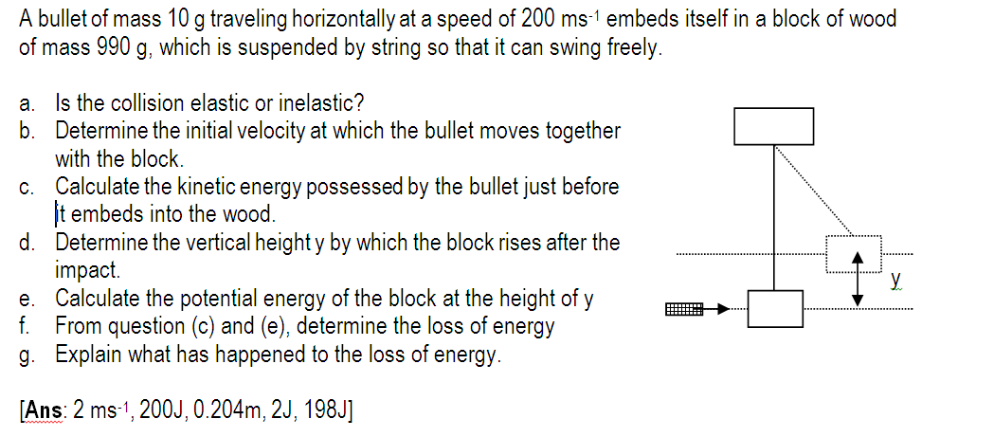
The loss in KE is converted into heat energy
due to the work done to overcome friction between bullet and block,
which is then absorbed to increase the internal energy of bullet and block.

Slide 30
Efficiency
Machine – a device which converts energy from one form to another
Car engine converts chemical energy (stored in petrol) into KE of moving parts and wheels & to other unwanted forms, e.g. heat & sound.
It fails to convert all the energy into useful energy. Therefore, the efficiency is not 100%.
Energy input
Useful work done
Wasted energy
Efficiency = useful work done/ energy input

Slide 31
Example
A power supply is connected to a shower unit via a cable.
Heat energy Q₁ is dissipated from the cable due to its electrical resistance.
Heat energy Q₂ is supplied dissipated from the heating elements in the shower unit due to its electrical resistance.
Assuming no other loss of energy, the efficiency of the circuit is given by ………………….

Slide 32
Learning outcomes
(m) define power as work done per unit time and derive power as the product of force and velocity
(n) solve problems using the relationships P = W/t and P = Fv.

Slide 33
Power
Power is defined as the rate of energy conversion or the rate of work done
P = dw/dt
Js⁻¹, W
Scalar quantity
Energy from engine
C
B
A
Running time

Slide 34
Examples
(1) A power station has an efficiency of 40% and generates 1000MW of electrical power. What are the power input & the wasted power? [2500MW, 1500MW]
(2) An electric motor is required to haul a cage of mass 400 kg up through a vertical height of 1200 m in 2 minutes. What will be the electrical power required if the overall efficiency is 80%? [49kW]

Slide 35
P= Fv
P = dW/dt = d(Fs)/dt
If force is constant, P = F ds/dt
Average power P = F <v> , where <v> is the average speed.
If speed is constant, <v> = v else <v> = (v+u)/2
Instantaneous power P = Fv where v is the Instantaneous speed

Slide 36
example
The manufacturer claims that the maximum power delivered by the engine of a car of mass 1200 kg is 90 kW. Determine the minimum time in which the car could accelerate from rest to 30 ms⁻¹. [Ans: 6s]
An independent test quotes a rest to 30 ms⁻¹ time of 13.4 s. Account for the difference of the time you have calculated.

Slide 37
Try this
An elevator has a mass of 1000 kg and carries a maximum load of 800 kg. A constant frictional force of 4000 N retards its motion upward. What is the maximum power must the motor delivered to lift the fully loaded elevator at a constant speed of 3 ms⁻¹? [65kW]

Slide 38
Problem solving
A car of 500 kg is moving up a ramp with a constant velocity 3 ms⁻¹. The ramp is inclined at 45º. A constant frictional force of 100N acts on the car.
Determine
the increase in KE per second
the increase in GPE per second
Heat dissipated per second
output power of the car engine
[10405, 10703, 16K]
If the efficiency of the car engine is 65%, determine the input power of the car engine.

Slide 39
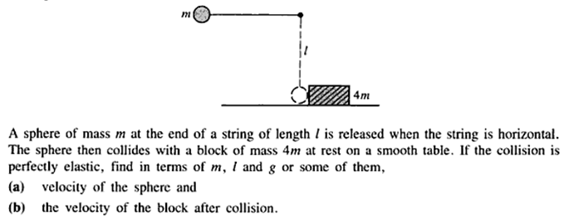
Problem solving

Slide 41
The End

